Slide 2
Transform On-Premises Backup With The Cloud

Slide 3
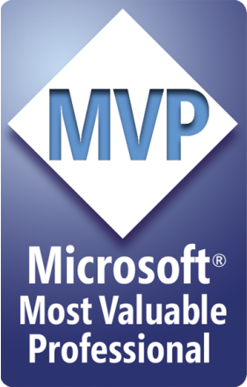





Aidan Finn
Technical Sales Lead at MicroWarehouse Ltd,
MVP, Cloud & Datacenter Management (Hyper-V)
Experienced with Azure, Hyper-V, Windows Server/Desktop, System Center, and IT infrastructure
http://www.aidanfinn.com
http://www.petri.com/author/aidan-finn
@joe_elway
aidanfinn.com

Slide 4
Dude, Where’s My Demos?
Lots of demos in this session
A little PowerPoint just to help tell the story

Slide 5
What is IT?

Slide 6
Why Are We Employed?
Provide tools and services to enable the business to operate
What’s of value?
Deploying assets
Enabling security and accessibility
Rapid responsiveness
Protecting assets
What’s not of value?
IT for the sake of IT
Cataloguing/indexing tapes

Slide 7
"My Backup Tool is Awesome"
It might be
But is it what you need?
Was the capital expenditure (CAPEX) really worth it?

Slide 8

These Guys

Slide 9
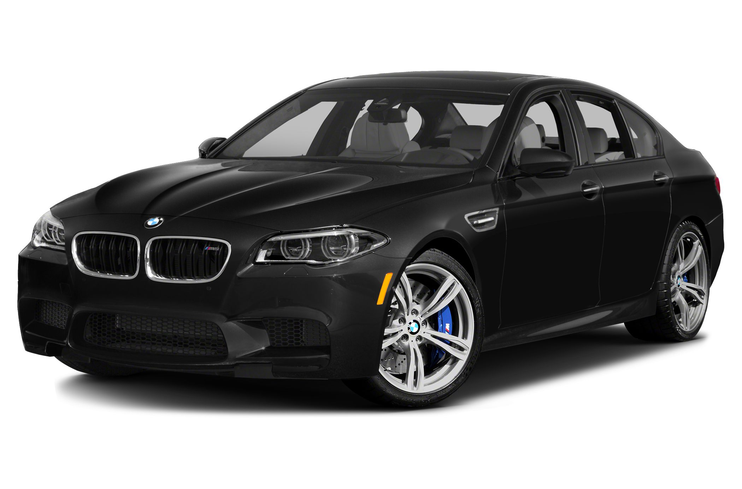
Tell Me I Should Drive This

Slide 10

The Best Experience & Features

Slide 11
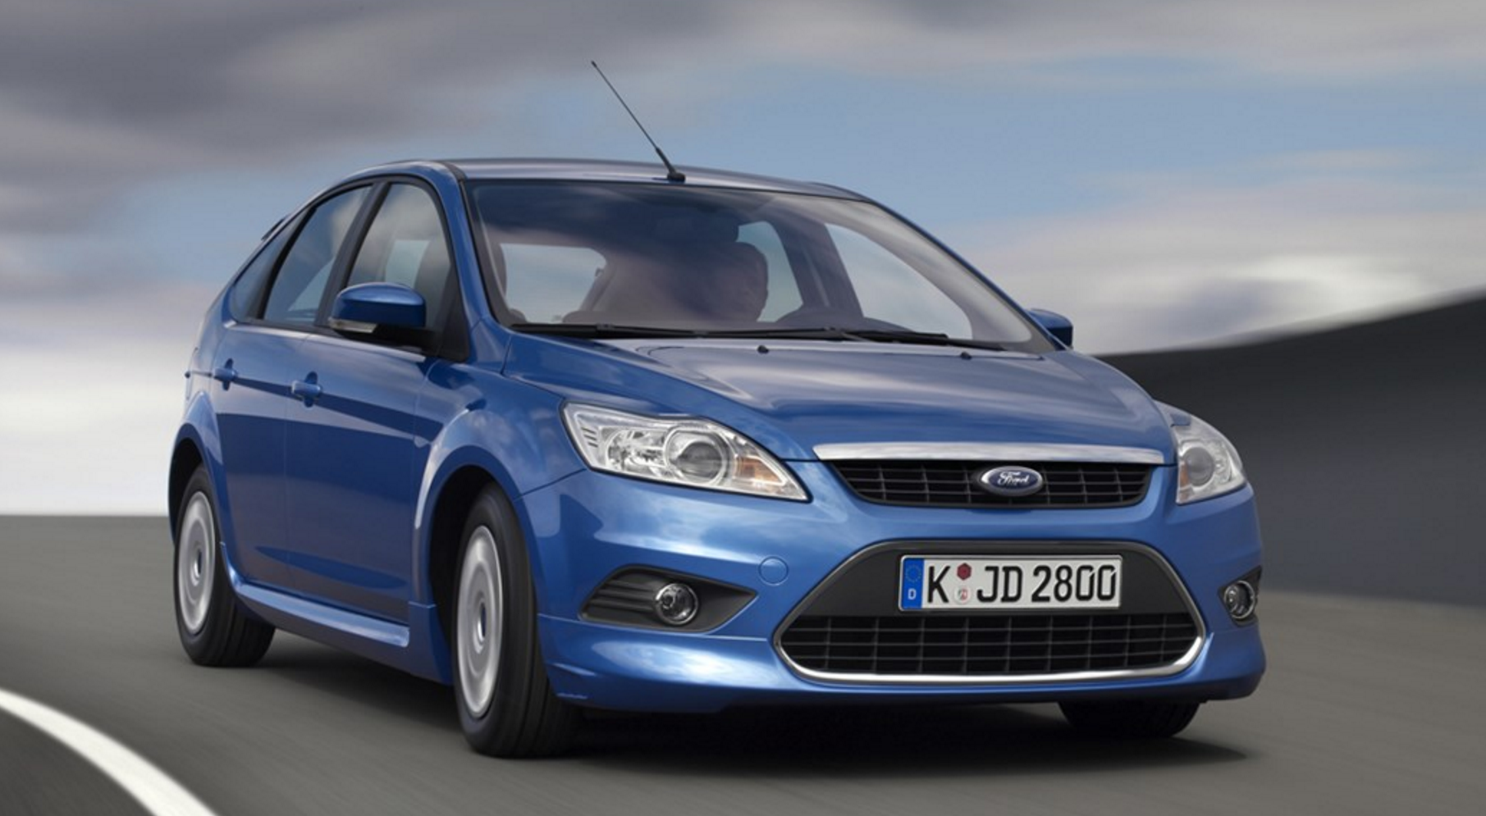
But I Choose To Drive One Of These

Slide 12

What’s This Got To Do With Backup?
We are not paid to play with backup tools
Bells and whistles are useless
The business wants these things from my backup tools:
Quick/reliable backup
Quick/reliable restore
Short- & long-term retention
Cost effectiveness
IT to use it as little as possible

Slide 13
Cloud-Era Backup

Slide 14

The Never Ending Love Affair With Tape
Transistor radios weren’t available yet
“The Day the Earth Stood Still” was released
Tony Bennett was topping the music charts
We still hadn’t sent a craft into Space
The first hydrogen bomb wasn’t detonated

Slide 15
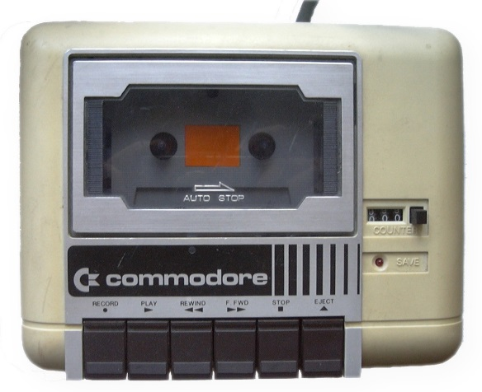
Tape Huggers
Tape drives
Unreliable
Lifespan isn’t as long as required retention
Tape Media
Unreliable
Expensive
Slow to restore
Off-Site Storage
Replication = impossible
Re-call of tapes takes too long

Slide 16
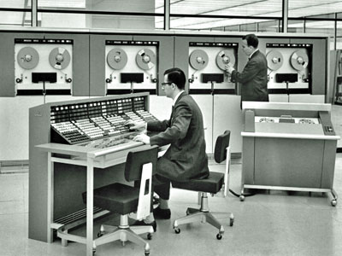
Pre-Virtualization-Era Backup
Traits
Perpetual (CAPEX) licensing
Existed before virtualization
Often uses tape as primary media
Disk-to-Disk (D2D) backup is secondary
Backup/restore of VMs is buggy or non-existent
Comfort food for the tape huggers
Seriously, dump this stuff now!

Slide 17
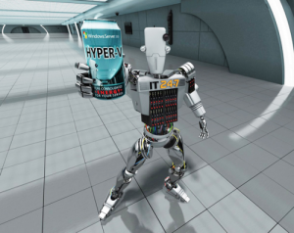
Virtualization-Era Backup
Traits:
Perpetual (CAPEX) licensing
Designed for vSphere/Hyper-V first/only
Backs up to disk first/only
Using the cloud as backup media is a MacGuyver solution
Can support using the cloud for backup media
Often misses the point – reducing costs and wasted effort
Focus on features, not service & cost

Slide 18

Cloud-Era Backup
Traits
Pay-as-you-go (PAYG) service charge (OPEX)
Cloud storage is primary backup media
Can support local disk-based backup media
Focus is on service & cost, not features
Solves many traditional problems:
Retention
Security
Compliance
Cost of backup hardware

Slide 19
Cloud-Era Backup by Microsoft

Slide 20
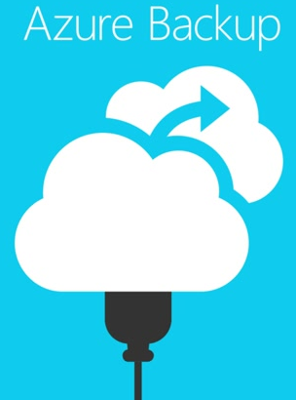
Azure Backup
Cloud-era backup from Microsoft
Azure blob storage
Very affordable
Cloud-scale
Geo-redundancy
Trust no-one (TNO) encryption
Yes, you can keep local backups too
Different types of service
Small-medium customers
Large customers

Slide 21
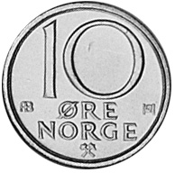
The Key Differentiator of Azure Backup
The cost of Azure storage!
Starts at kr0.1947 / GB / Month
RRP – less with CSP/EA
LRS Hot Blob
Note:
Does not include instance charges
More on this later
Just one of many Azure services

Slide 22
Three On-Premises Azure Backup Solutions
 | MARS Agent | System Center DPM | Microsoft Azure Backup Server (MABS)
Solution | Disk-to-Cloud | Disk-Disk-Cloud | Disk-Disk-Cloud
Point of management | Agent (Portal support coming) | DPM Server | MABS (Portal support coming)
Backups supported | Files & folders ONLY | Files & Folders Hyper-V SQL Server SharePoint Exchange ESXi (2012 R2 UR 11) | Files & Folders Hyper-V SQL Server SharePoint Exchange ESXi (MABS Update 1)
Tape support? | No | Yes | No
Recovery Points in the cloud | 9,999 | 9,999 | 9,999
Maximum Retention | 99 years | 99 years | 99 years
Security Model | Trust No One | Trust No One | Trust No One
Traffic Shaping | Yes | Yes | Yes
Backup Traffic Window | No | Yes | Yes
Max online backups per day | 3 | 2 | 2
Software Cost | Free | System Center per physical machine | Free

Slide 23

FAQ – Part 1
Is data encrypted?
Yes, before it leaves customer site (AES256)
Microsoft has no access to the secret key
Is data compressed?
Yes, but not de-duplicated
Can I have a local restore cache?
Yes, with DPM or Azure Backup Server
Does it support Windows Server 2003/R2
Microsoft ended support on July 14, 2015

Slide 24
FAQ – Part 2
Can I restore local VMs into Azure from my Azure Backup?
No – you have confused Backup and DR
See Azure Site Recovery (ASR) for DR
Is Azure Backup Server free?
Yes, the software is free
You pay instance charges for local (including local-only) backups
You get online backup for the price of storage consumed – which is very small!

Slide 25
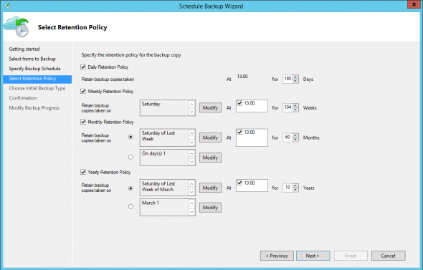
Long-Term Retention

Slide 26

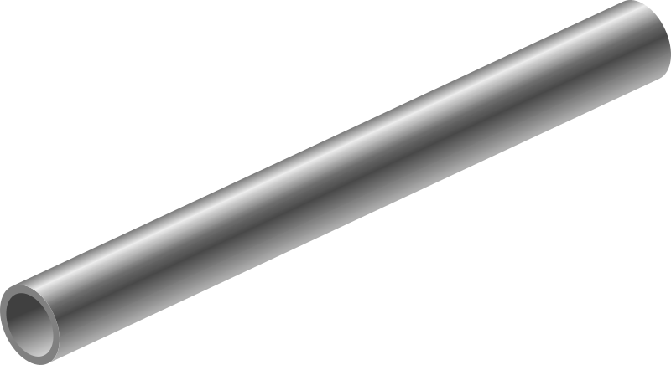
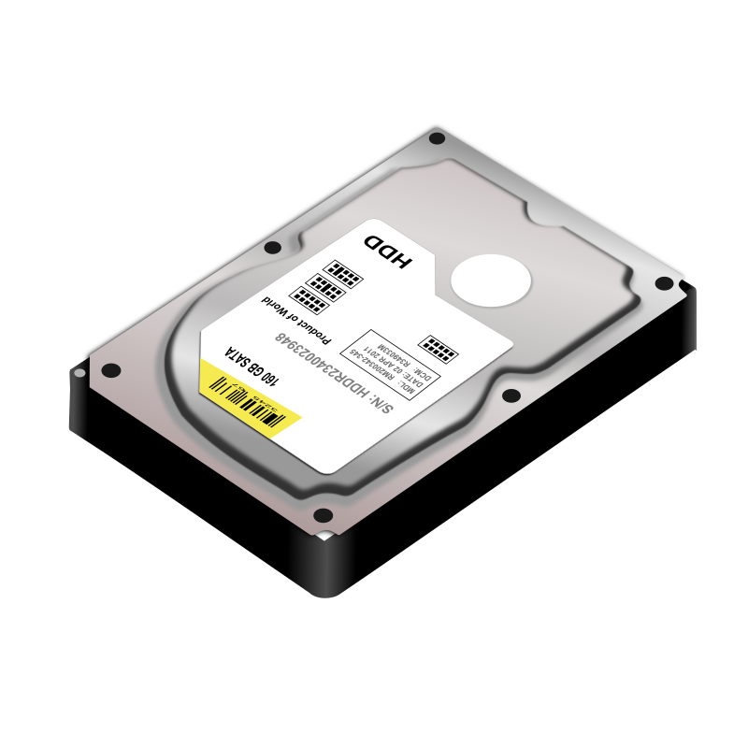


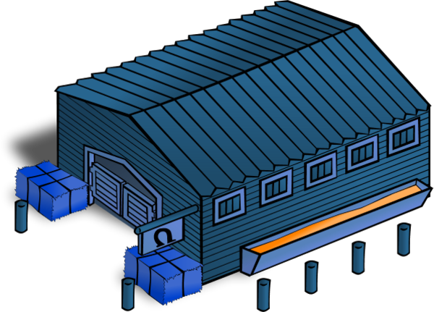
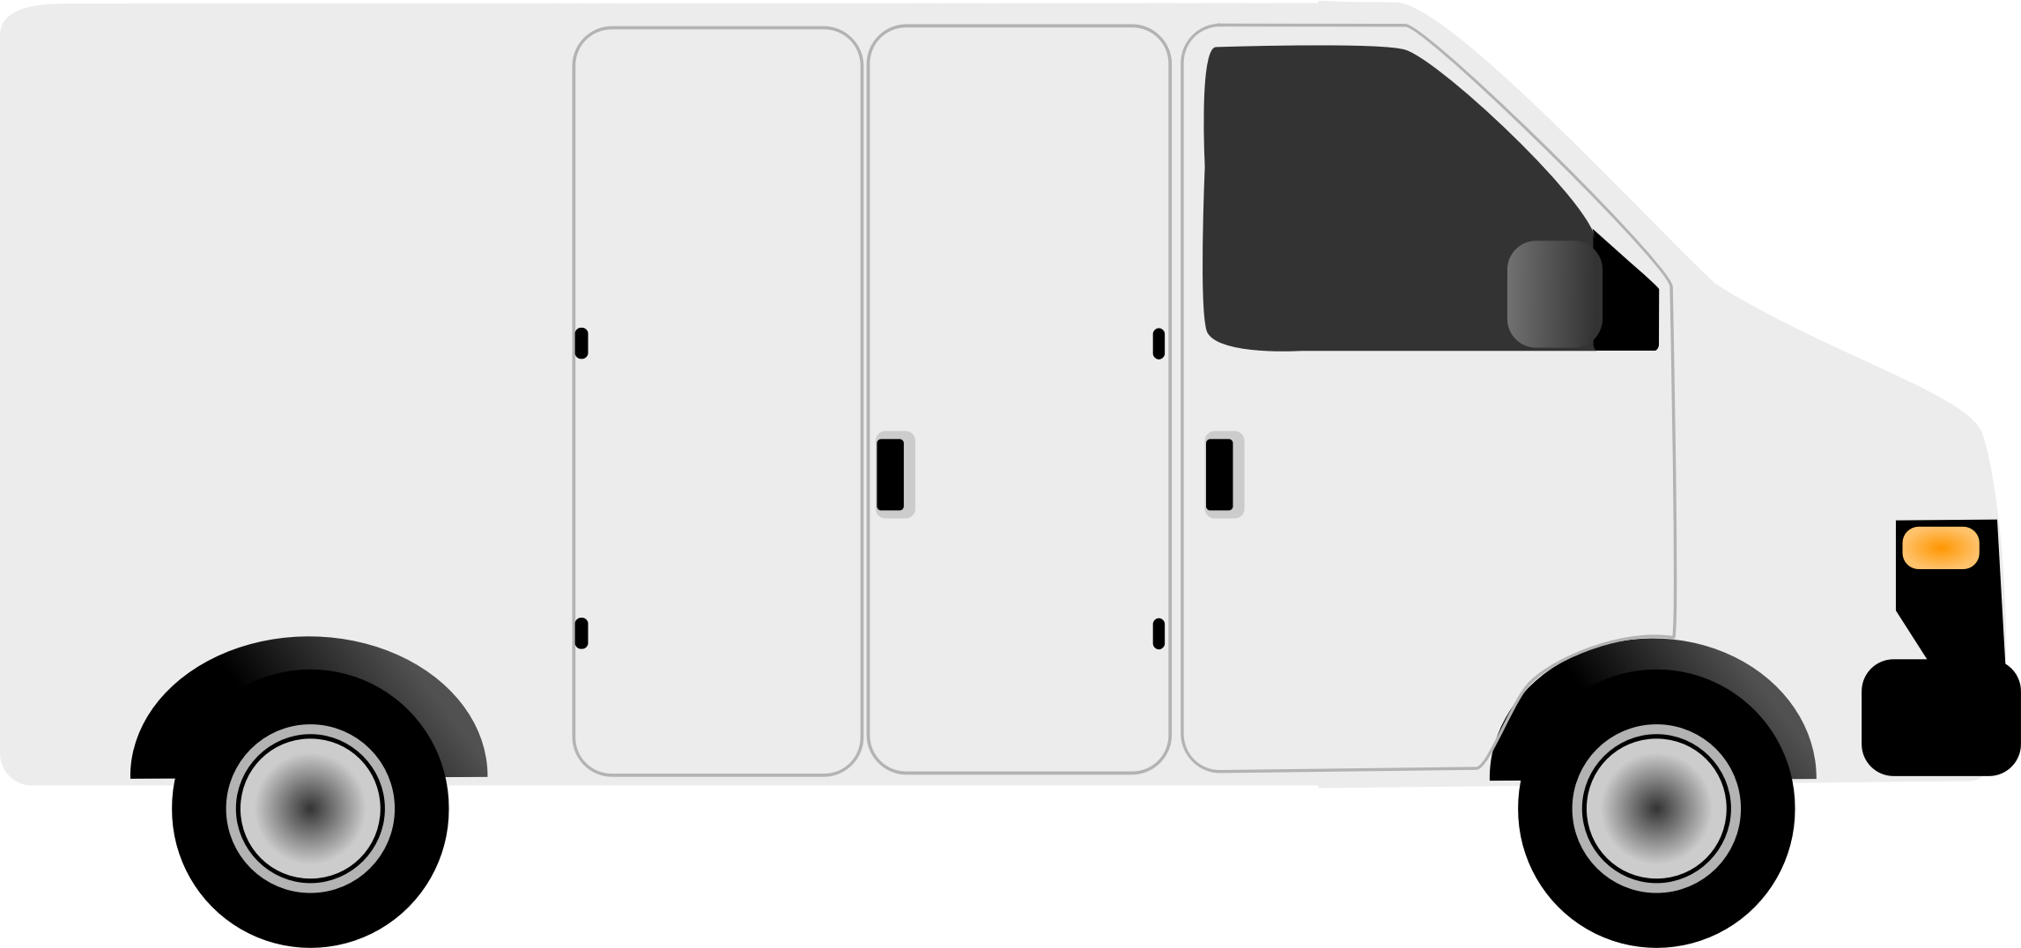
First Backup – Offline Option
Azure Backup
Customer Site

Slide 27
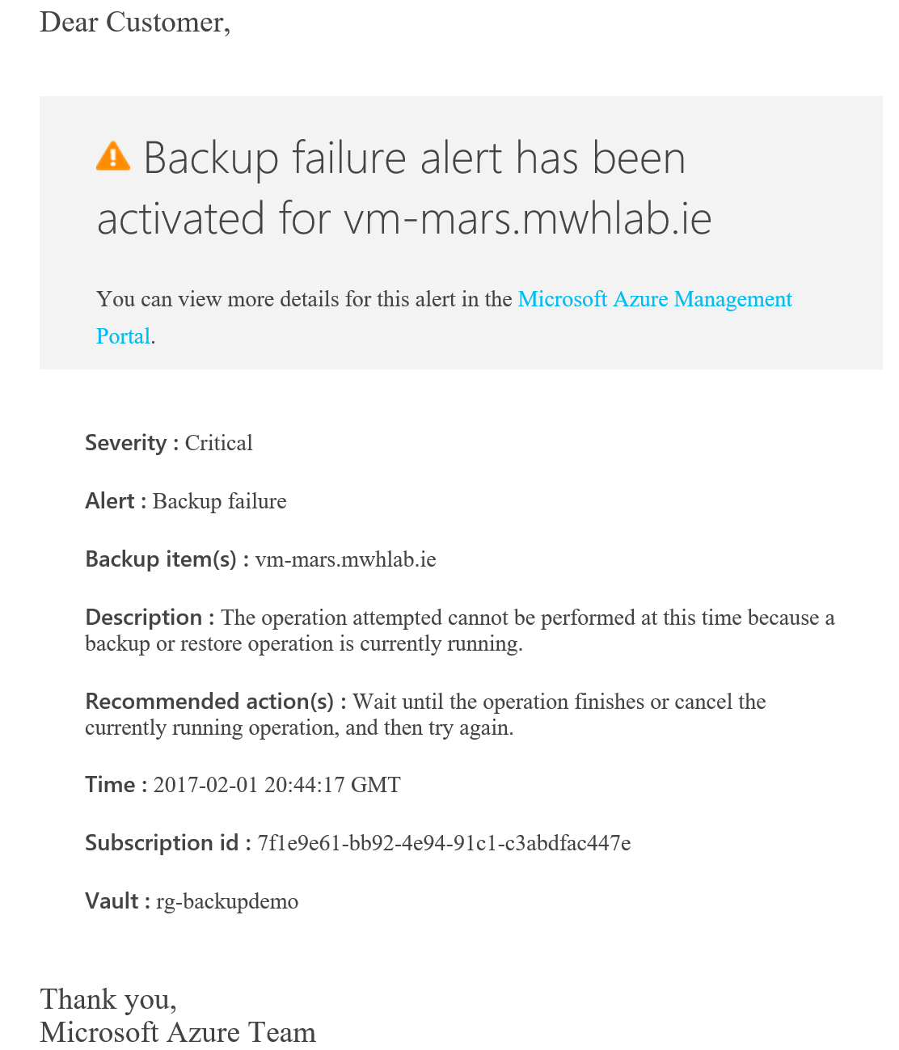
Email Alerts
Manage by exception
Track backup alerts in the recovery services vault
Email alert options:
Critical
Warning
Informational
Frequency options:
Per-hour digest
Per-alert

Slide 28
MARS Agent

Slide 29

How MARS Agent Works

Slide 30
MARS Agent Demo

Slide 31
Microsoft Azure Backup Server

Slide 32



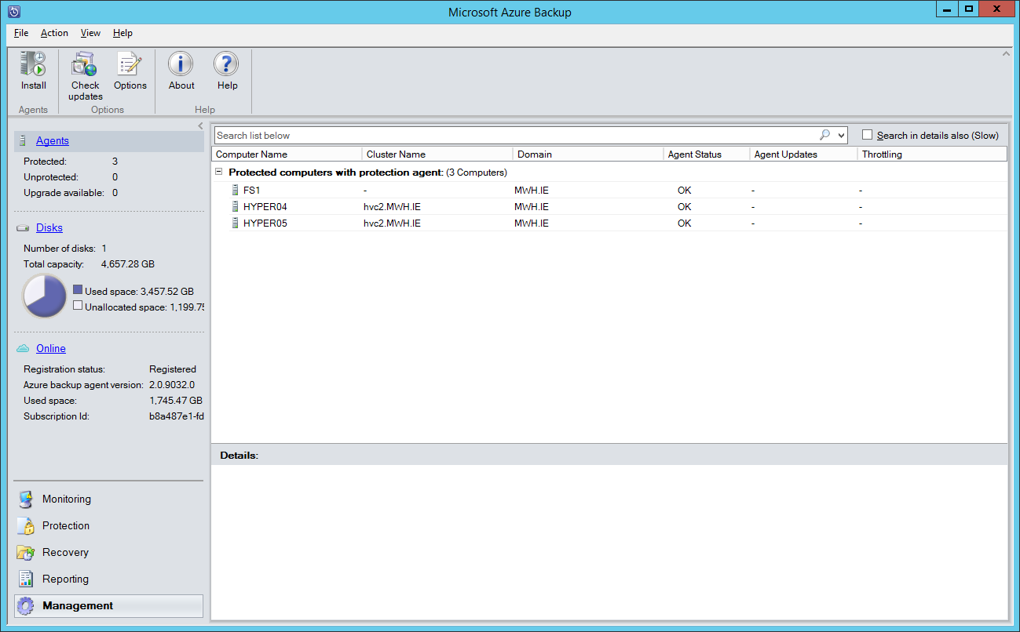
How MABS Works

Slide 33
Staging Location
Easy requirement to forget
Temporary location
Used when restoring from Azure
Folder must have free capacity:
Size of a database being restored
Size of 10 VMs being restored at once

Slide 34
MABS Demo

Slide 35
Pricing of Azure Backup

Slide 36
Common Pricing
MARS agent
Hot blob storage consumed
Instance charges
Azure Backup Server
Hot blob storage consumed
Instance charges
System Center Data Protection Manager
Hot blob storage consumed
Instance charges
System Center / OMS volume licensing

Slide 37
Blob Storage
Hot Blob LRS, starting at kr0.1947 / GB / Month
Approx. kr199.38 for 1 TB / month
Approx. kr19,938 for 100 TB / month
Notes:
North Europe retail pricing above
Compression reduces storage consumption
Retention increases consumption of storage

Slide 38
Instance Charges
Price you pay for backing something up
Total size of files & folders on 1 machine
Total actual VMDK/VHD size of a VM
Three charges:
0 – 50 GB: kr31.47
50 – 500 GB: kr62.93
500+ GB: Multiples of 50 – 500 GB charge (e.g. 2 * kr62.93 for 700 GB)

Slide 39
Azyre Backup Pricing Myths
Source: Azure Backup Pricing https://azure.microsoft.com/en-us/pricing/details/backup/

Slide 40

Summary
Are you an accidental backup admin?
Embrace the cloud
Using true cloud services
Reduce:
Wasted effort
CAPEX costs
Increase:
Retention
Security
Launch a raid on those tapes!

Slide 41

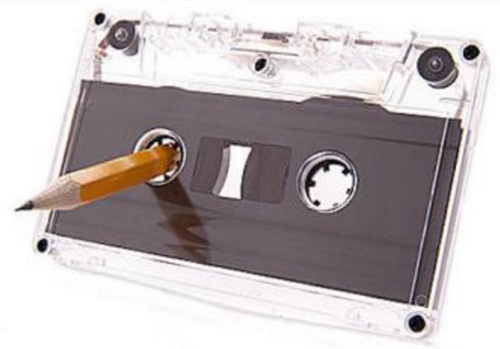

Thank You!
@joe_elway
aidanfinn.com

